Slide 1
A collection of sonnets (mostly in Lithuanian)
A Pierre-Édouard Lémontey classic

Slide 2
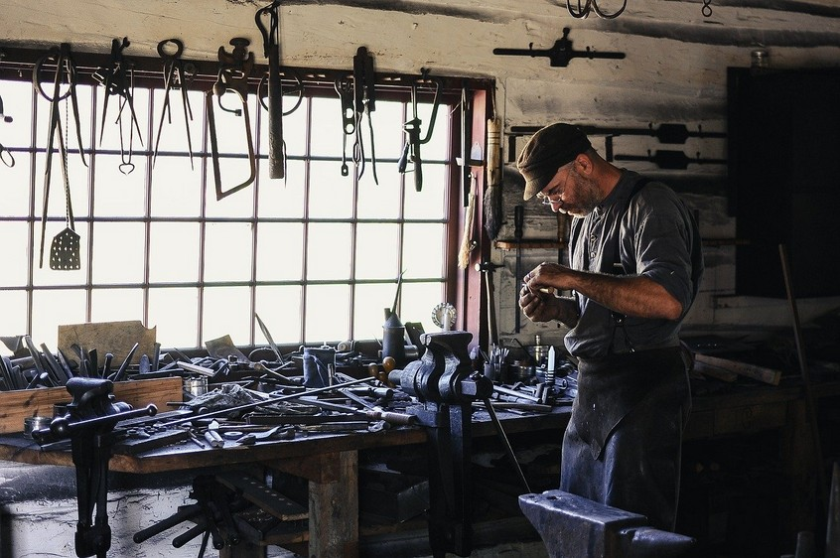
The wizard's outburst
Znate li kada bi
trebala biti završena
Stjepanova zapovijed?
Jebi Stjepana!
Bit će spremno kad
bude spremno.

Slide 3
The wizard's outburst
Da dobro, samo da
to obavimo, hoćemo
li?
Hej, ne pucaj u glasnik!
Osjećam se isto kao i ti.

Slide 4
The wizard's outburst
Dečki, brifing o zdravlju
i sigurnosti uskoro počinje
O bože, ne ove
gluposti!
Postoji li besplatna
hrana?

Slide 5
The Flantamperous-Wedge sisters
Thirty years prior to this, Vanessa Flantamperous-Wedge is returning home from a night out with her sister, Michelle.
The night has thus far simmered with the kind of mirthful merriment that is the enclave of the young, and yet has not descended into rambunctiousness proper.
It is 3:37am in either Sunderland or Florence, and the first stirrings of sunrise are already perceptible.

Slide 6
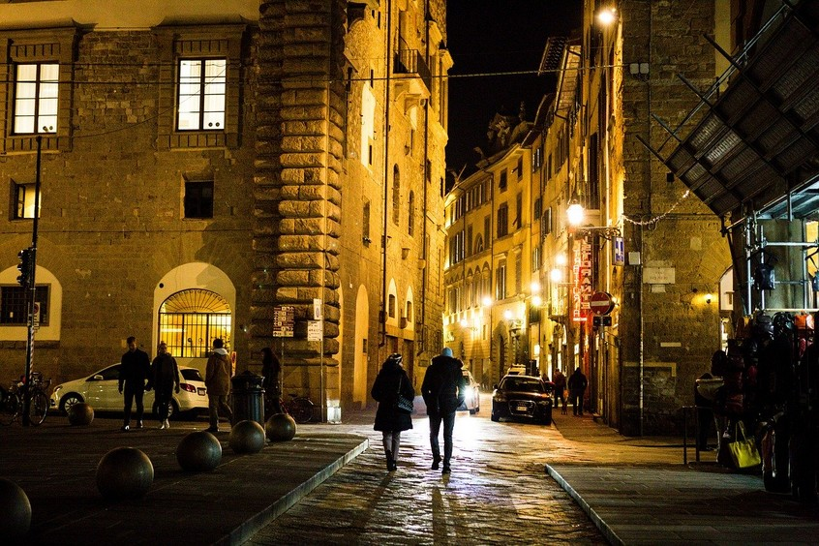
The Flantamperous-Wedge sisters (then)
Yeah so then I
was… Wait what
was I saying again? Ah
never mind! You should
text ma that we're
heading home.
Already did, sis!
Anyway, you were
saying something
about a shortcut,
weren't you?

Slide 7
The Flantamperous-Wedge sisters (then)
Aha! Well it's not
a "shortcut" per se…
But follow me.
It's not gonna be that
industrial estate is it?
Dunno how safe
that'll be at this time
o' night...
Hmm, I can promise
nothing, I'm afraid.

Slide 8
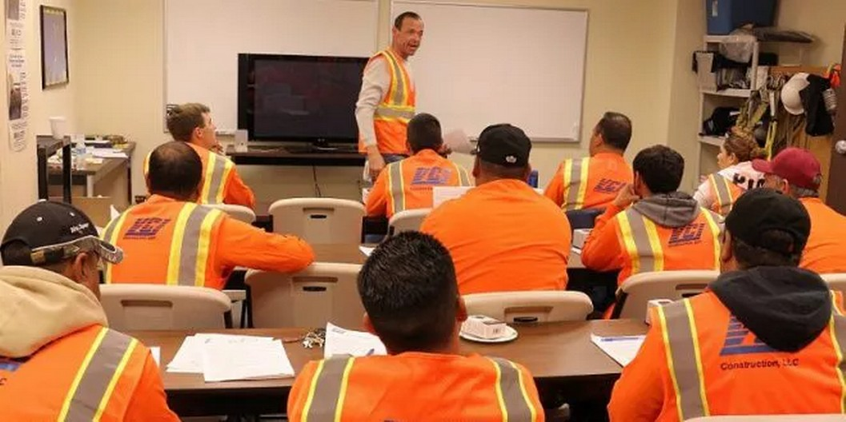
The wizard's outburst
Dakle, prvi korak o
kojem bismo trebali
razmisliti je kako
prepoznati opasnosti.

Slide 9
The wizard's outburst
Drugi korak:
odlučite kome bi
moglo naštetiti.

Slide 10
The wizard's outburst
Četvrti korak: Zabilježite
značajne nalaze…
Da, Ivane?
Gdje bismo trebali
snimiti ove stvari?
Dobro pitanje, Ivane. Zbog--
Ispričajte me?

Slide 11
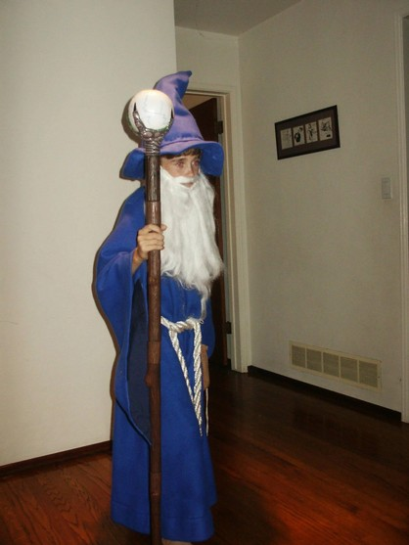
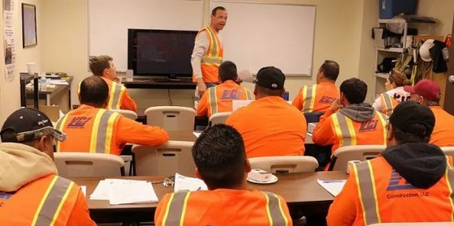
The wizard's outburst
Gentlemen, I demand that
you permit me examine
your lips!
Tko je dovraga ovaj kreten?

Slide 12
Aims
Attain a basic familiarity with South-Eastern European health and safety legislation
Be able to distinguish between quite specific descriptions of events in the recent past and presumed foreshadowing that in hindsight was obviously outrageously fanciful.
Understand some common budgetary concerns when manufacturing "rustic-chic" tableware

Slide 13
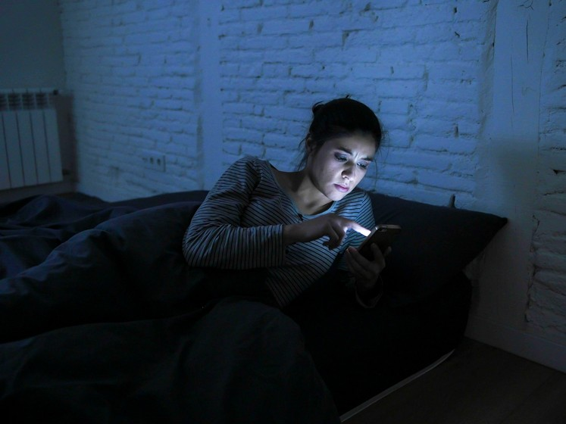
The Flantamperous-Wedge sisters (now)
What the hell was that
noise? I hope Vanessa
is awake...

Slide 14
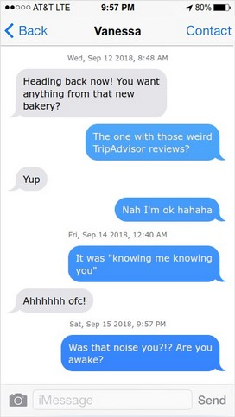
The Flantamperous-Wedge sisters (now)

Slide 15
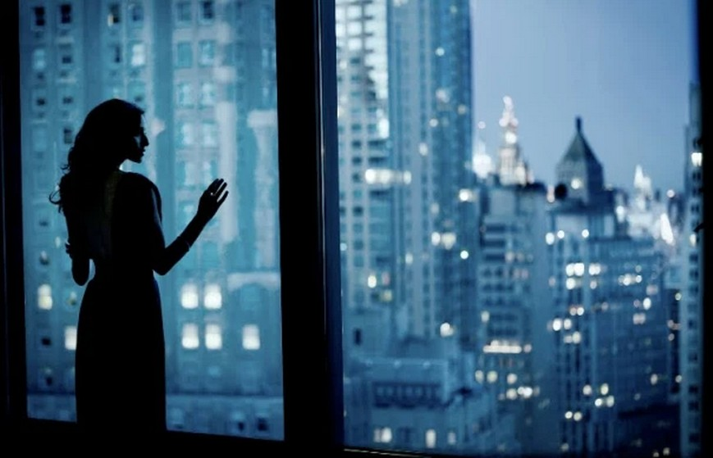
The Flantamperous-Wedge sisters (now)
Hey! Can I help you?
What do you want?
Some of us are trying to
sleep, you know!
Are you throwing…
Paperback books?

Slide 16
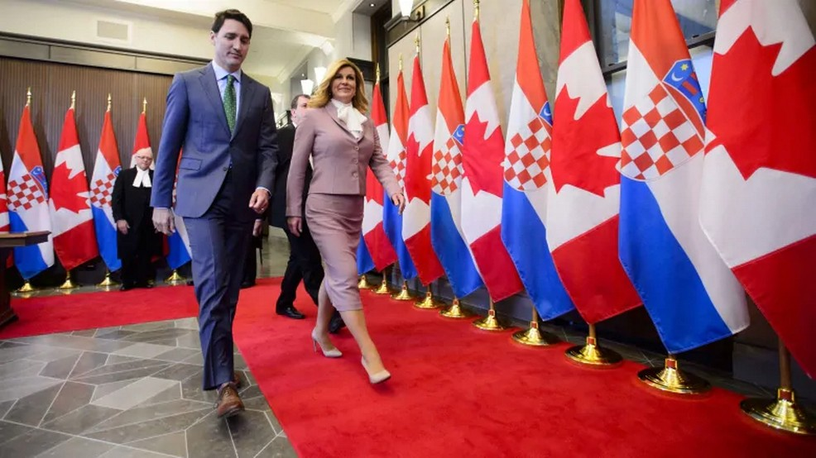
Pad Thai-plomacy
Ah, I never can understand
these trends. What does it
even mean: "you're
right to be skeptical"?
Skeptical about what?
It's really big back home,
actually. All the kids are
saying "my whole life's
work is in this glass", and
so on and so forth.

Slide 17
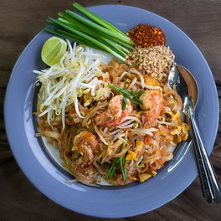
Pad Thai-plomacy
'tis I! 'tis I, a sentient
Pad Thai! Here to
confer great wisdom
'pon thy. Et cetera.
You get the point.
Hmm, I'm really not
sure I do, though...

Slide 18
Hyper-specific writer's block
Alas, my wavering
inspiration seems directly
proportional to the
specificity of my
book titles...

Slide 19
Hyper-specific writer's block
Still, if I could finish
"Thickening Gum" and
"10 Ways to Prepare a Zanat",
then I can finish this!

Slide 20
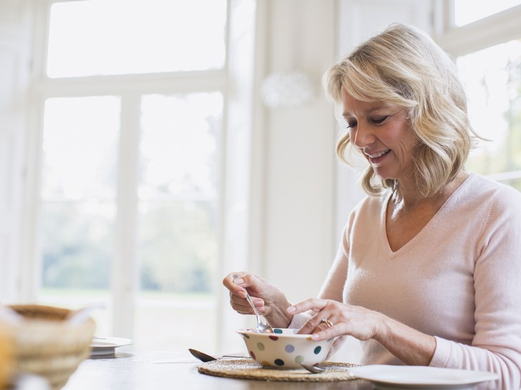
"Work sucks, I know"
Ivane, dođi vidjeti!
Improvizirano kazalište
u mojoj zdjeli sa žitaricama!

Slide 21
Improvizirano kazalište
Characters:
Jimmy Cereal – just an oat
Manfred Surveillance – much more than just an oat
Phillippa Handshake – not an oat, not yet a woman

Slide 22
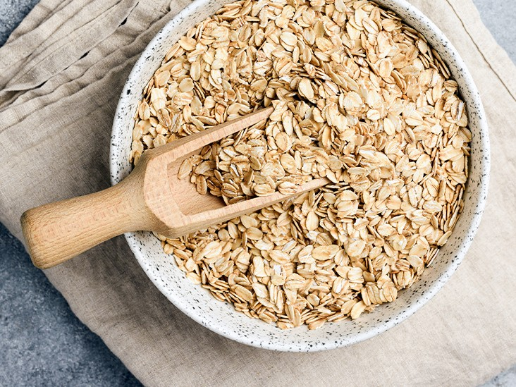
Improvizirano kazalište
Ok so here me out.
Idea for an improvised
dramatic thing: working
title – "Old Hummus in
Greater Manchester"
I'm hooked already.
What's it about?

Slide 23
Improvizirano kazalište
So it's basically just
some bloke
exhaustively making
vowel sounds–
Sounds compelling,
but...
Until one day he wakes
up and realises that he
is not actually in
Greater Manchester.
Ah, there it is! Another
instant classic, Manfred!

Slide 24
Hyper-specific writer's block
Anyway, my as-yet unborn
great nephew is bound to be
quite the literary prodigy. He
will surely help with proofing.

Slide 25
The wizard's outburst
Lips! Lips, yes? I need to
take a look at them
immediately.
Može li ga itko razumjeti?

Slide 26
The wizard's outburst
Look there's no need to be
alarmed. It's not like this is
some kind of lip heist...
Govori nešto o... Usnama?

Slide 27
The Flantamperous-Wedge sisters (now)
Do you want me to read
the book? Is that it? What
book is it, anyway?
"A guide to"… What? OK,
I'll just take a look at one
of them and see...

Slide 28
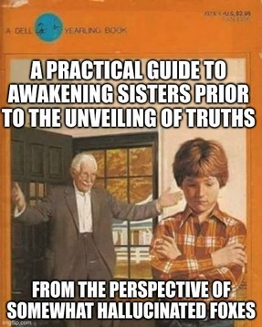
The Flantamperous-Wedge sisters (now)

Slide 29
The Flantamperous-Wedge sisters (now)
You know these are all
empty, right?
Read the preface!

Slide 30
The wizard's outburst
Jeste li revizor? Ovaj…
Audit– Auditor?
What? No I am demonstrably
a wizard. Came from the Four
Caves, all about the lips now.
It's harvesting season, baby!

Slide 31
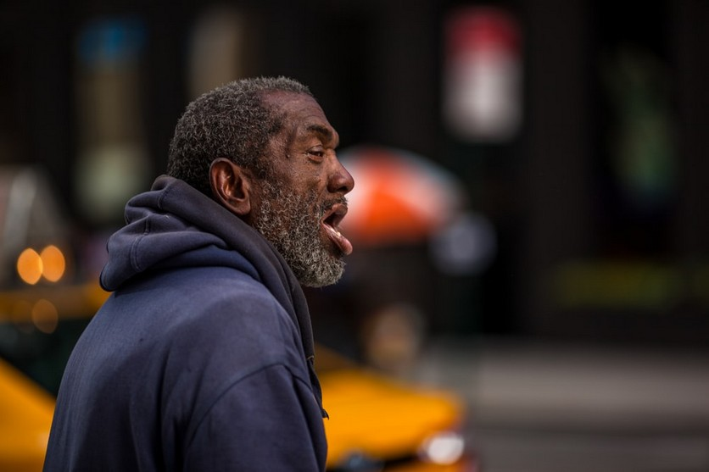
Old Hummus in Greater Manchester
Ahh! Eeeee! Oooh! Owwww!
Aoowww! Euuuwww! Eurrghhh!
Awwww! Aargh! Aaaaaa!
Eh! Eh! Ih! O! Ohhh! Oi! Oooh!
Uh! A! Ayyyy! Ah! Or! Eu! Aye!

Slide 32
Old Hummus in Greater Manchester
Wait a second… This doesn't
look like Greater Manchester…
But then, where have I been
all these years?

Slide 33
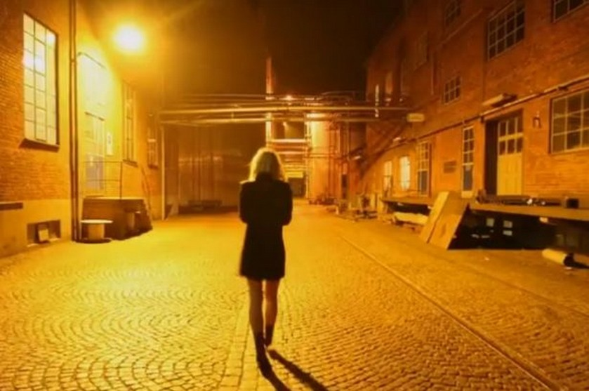
The Flantamperous-Wedge sisters (then)
Come on Michelle, keep
up! We can cut through
an alleyway just over here.
Slow down a bit, would
you? I need to practice
walking at a "gentle" pace
in case I'm someday cast
in a biopic about someone
who walks with that general
cadence.

Slide 34
The Flantamperous-Wedge sisters (then)
Hey, what's that over there?
Do you see it? Looks like a
badger or something!
Already clocked him. Is it
just me, or does it look
like he's trying to
say something to us?

Slide 35
Pad Thai-plomacy
Well then, allow me to elaborate.
Sometimes we bear witness to
events that seem premised upon
either implausible nonsense or
downright whimsy...
Yes, I can see that.
Seen it all before,
mate.

Slide 36
Pad Thai-plomacy
The thing is, such contrived
unfoldings quite often convey no
actual meaning, nor have any
impact whatsoever on one's
conceived "narrative arc"
And yet, they cannot
be easily dismissed.
Can they? No. But
maybe also... Yes?

Slide 37
Improvizirano kazalište
Damn! Emotional stuff.
But where had he been
all that time, then?
Oh just somewhere near
Stoke I think. It doesn't
end up making much
difference to him in the
end, though...
Well if that ain't the
truth! Nothing ever
does...

Slide 38
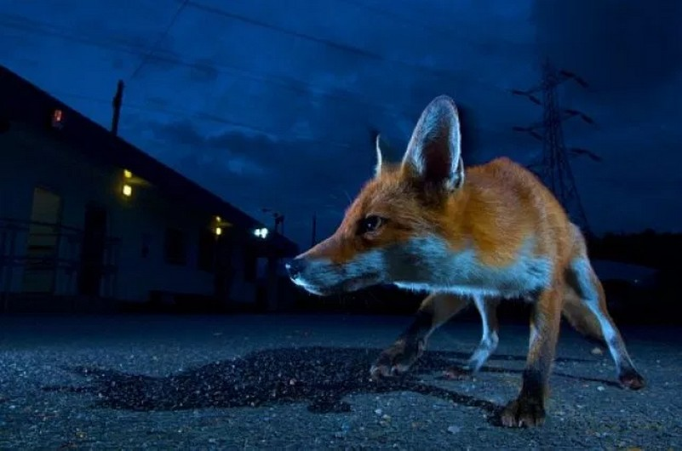
The Flantamperous-Wedge sisters (then)
Badger? Pfft, this is a fox you're
dealing with! Well, kind of – I'm
sort of mostly hallucinatory
(yeah, you've had a few), but for all
intents and purposes I'm basically
a fox. You know what it's like.

Slide 39
The Flantamperous-Wedge sisters (then)
Vanessa, Michelle, it's been real
good to meet ya. Really. But never
mind all that! I have big, big dreams
for you two. Big dreams. And it all
starts with you breaking into that
factory there and grabbing me a
regular ol' barrel o' yeast!

Slide 40
The Flantamperous-Wedge sisters (now)

Slide 41
The wizard's outburst
Oprosti, što?
Right this obviously isn't gonna
work, is it? For now, I shall take
my wizarding elsewhere! Let it
be known that, on this day, the
great… ermm… wizard…
spared you!

Slide 42
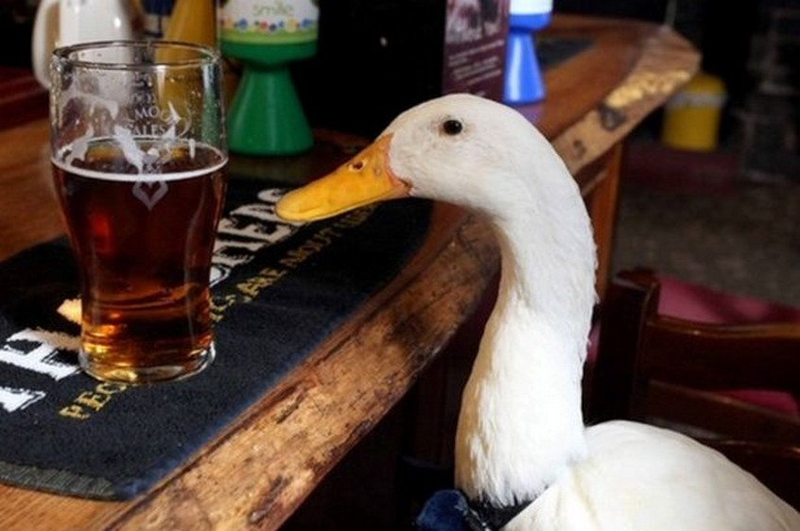
The Flantamperous-Wedge sisters (then)
Wow, you were right, top place!
Great joint to get my goose on,
kick back and just sip a smooth ale,
ya know?

Slide 43
The wizard's outburst
ŠŠŠŠto?
I bid you... A humble adieu!

Slide 44
"Work sucks, I know"
Zvuči fascinantno...
Ideš li danas na posao?
Daaaa... Trebao bih ići...

Slide 45
"Work sucks, I know"
Danas postoji obuka o
Zdravlju i sigurnosti…
Ali dobro, sada ću otići.
Vidimo se kasnije!
Zabavi se!

Slide 46
The Flantamperous-Wedge sisters (then)
Michelle! This is really no time for
practising lunges! Can we please
just take the damn barrel and get
outta here?

Slide 47
The Flantamperous-Wedge sisters (then)
'Nessa, I shall forgive your
ignorance, but right now what I'm
doing is administering the last rites
to this goose I know, called Dave.
He used to love lunges, so what
you've just said is actually very
disrespectful.

Slide 48
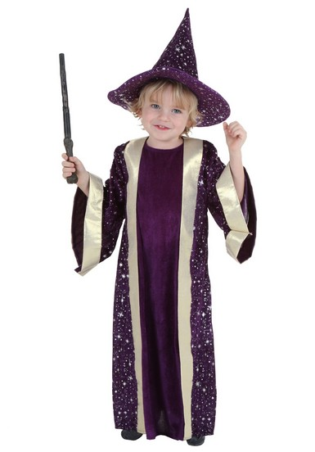
The wizard's outburst
Master, you have returned!
A good day's work, I trust?
Ah, my faithful understudy.
What a day I've had!

Slide 49
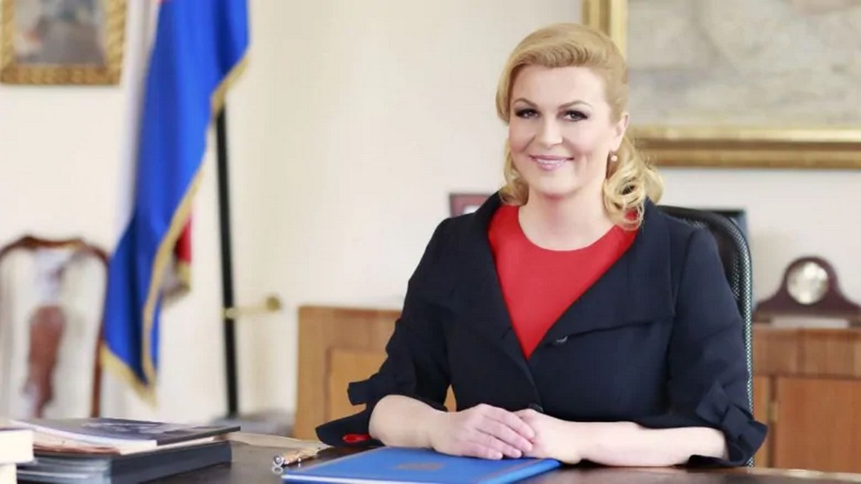
Pad Thai-plomacy
Dobro jutro svima!
Oprosti, što sam se
upravo probudio...

Slide 50
The Flantamperous-Wedge sisters (then)
Anyway, as I was saying… If Dave
were here with us today, he'd
probably want to say something
about the improbability of a goose
being coaxed off of this mortal coil
by a pissed-up gal lunging on a
barrel.

Slide 51
The Flantamperous-Wedge sisters (then)
My fondest memory of Dave was
the time that him and I went to a
restaurant together. I took his
picture and he joked that if anyone
were to search for it online, it would
prove elusive because the search
engine would return so many
pictures of people eating goose
instead. We were laughing for ages,
but we realised it was probably
true… Then it felt a bit morbid,
but still ultimately quite funny.

Slide 52
Recap so far...
We've gained quite a bit of insight into wizardry for children, and all the pitfalls associated therewith.
We've thought a bit about narrative structure, and how it's interrupted when we start letting every farmyard animal stick their oar in where it's not wanted.
We've avoided (so far) those clichéd fourth-wall breaking non-sequiturs that Pierre seems to love so much that he's probably crammed one in here somewhere anyway and we've been so brazenly Croatian(?) about it all to even notice.

Slide 53
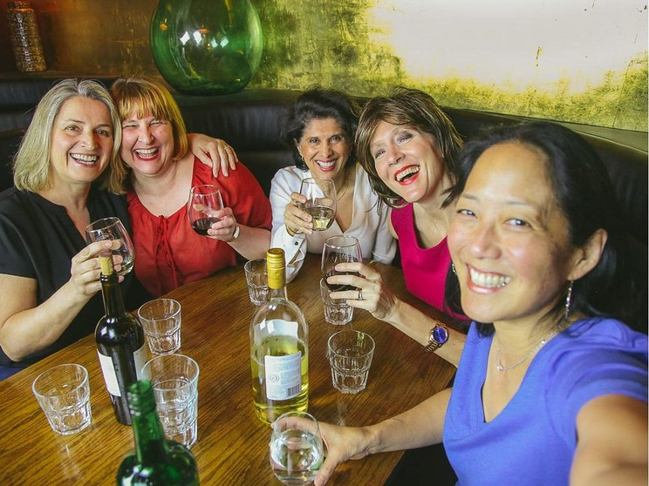
"Work sucks, I know"
Svim silama sam se trudio otići na
posao… Pokušao sam, ali konoba
je bila puno primamljivija

Slide 54
The Flantamperous-Wedge sisters (then)
Snap away, Michelle! I'll let
you know in just a sec why all
of your efforts are ultimately
fruitless. What? Well yeah, in
general too, I guess, but really
I meant in the context of you
taking this photo right now.
Mmm yeah, let me work it!
Check out my swagalicious swag.

Slide 55
The Flantamperous-Wedge sisters (then)
Right, enough about Dave! I'm
commandeering the yeast wagon
and steering us all the way to
(as they say back home) the
octopus lagoon!
We really gotta leave
so soon?
'fraid so, skipper me
ol' Flan-Wedger!

Slide 56
The Flantamperous-Wedge sisters (then)
Yo! Psst, fox! We got it...
You don't hafta shout, ya know? I'm
mostly hallucinated so it's all fine.
From the sounds of it though, one of
you accidentally activated a hydraulic
press on your way out. Oh, yep – I'd
know that sound anywhere!

Slide 57
"Work sucks, I know"
Konobar! Još jedan krug piva, molim
Odmah dolazim, gospođo!

Slide 58
Pad Thai-plomacy
Moramo sastaviti izvještaj.
Potrebno nam je što više
podataka o zdravlju usana
naše nacije.

Slide 59
Pad Thai-plomacy
Samo usne?
Pa, valjda cijela regija usta.

Slide 60
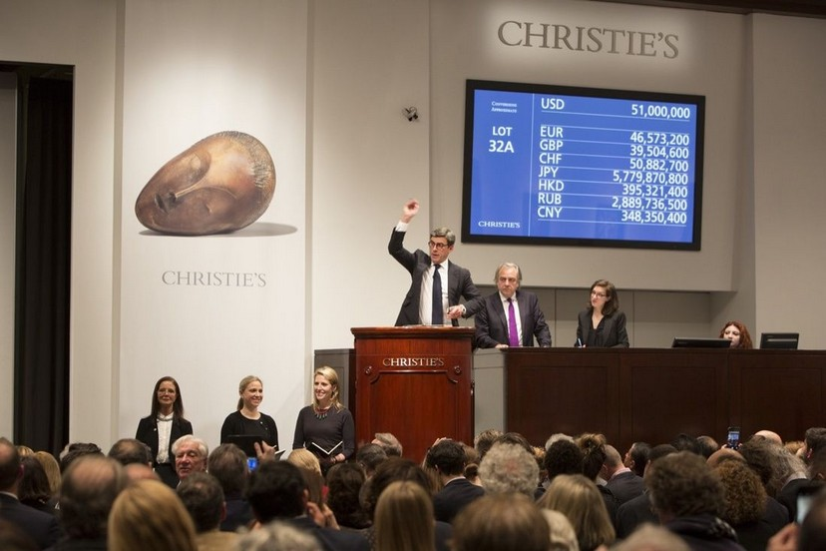
The Flantamperous-Wedge sisters (then)
...and ermm... I don't usually do
this but… Are you 100% sure
about this purchase? You are
aware that the item holds no
value whatsoever, and that the
"ale" recipe written upon it is
almost certainly poisonous?
Very well… Sold! To the
charming German goalkeeper
over there in the corner!
Jawohl!

Slide 61
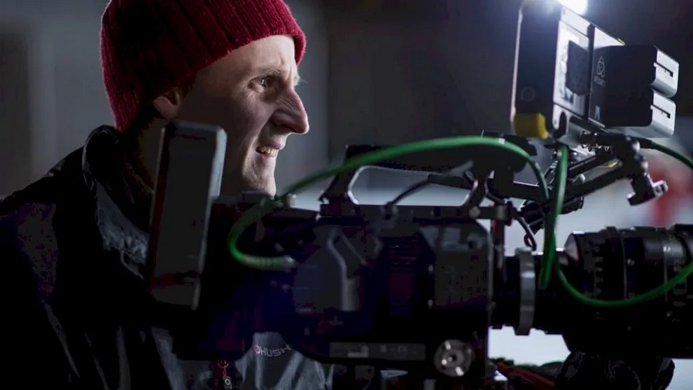
The Flantamperous-Wedge sisters (then)
Glib Glab Gloooooof!
There's the shot!

Slide 62
The Flantamperous-Wedge sisters (then)
Makes the whole night
worthwhile. I can't believe
they walked right into
that hydraulic press lever!

Slide 63
The Flantamperous-Wedge sisters (then)
Once I submit this to the Central
and Eastern European workplace
photography awards, I'll be
a shoo-in for "best occupational
Photographer" in… Whichever
region it is that I live in...

Slide 64
The Flantamperous-Wedge sisters (then)
Note to self, for later: figure out
where it is that I live. Priority level:
ermm… urgent.

Slide 65
The Flantamperous-Wedge sisters (then)
Anyway, irrelevant really! Irrelevant!
Get that yeasty barrel o' goodness
home with ya double-quick. Only
then, young ones, shall your real
journey begin! Yeah, I'll meet you
there, don't worry.

Slide 66
"Work sucks, I know"
Dobro odigrano!
Hvala!

Slide 67
"Work sucks, I know"
Kako biste željeli biti
predsjednik?
Samo ako!

Slide 68
"Work sucks, I know"
Ne šalim se, imam tu moć.
U tom slučaju, da.
Nemam više pitanja.

Slide 69
The wizard's outburst
Hmm yes, I guess with
hindsight one might have
anticipated some sort of a
language barrier.
One so seldom concerns
oneself with these things,
As a wizard.

Slide 70
The wizard's outburst
Well maybe that's there we
been goin' wrong all these
years, ya know?
Mohammed, I'd love to sit
around with you all day and
chat like a pair of metalworkers,
But we've got a narrative arc
to sustain here!
Aye, and a dire lack of
working men's lips.

Slide 71
The Flantamperous-Wedge sisters (then)
Hmm, no sign of that fox
Still… Maybe I've just
sobered up. Could I text him? Oh
wait – is that… I can hear...
something… Is that him?

Slide 72
The Flantamperous-Wedge sisters (then)
Vanessaaaa! Told you I'd be 'ere.
Right on time, too. Arguably too
punctual, if anything. Should I leave
and come back in five? Ah, no point!
Already made by big entrance now.

Slide 73
The Flantamperous-Wedge sisters (then)
So, the yeast. You're gonna wanna
get to work on brewing with that.
You know how to brew beer, yeah?

Slide 74
The wizard's outburst
As I recall, weren't you
supposed to remember
something after the great,
albeit unsuccessful lip heist?

Slide 75
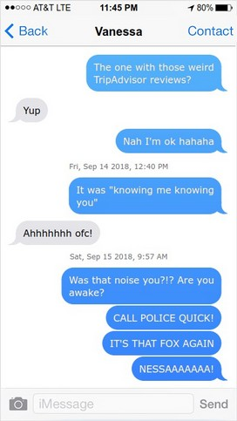
The Flantamperous-Wedge sisters (then)

Slide 76
The Flantamperous-Wedge sisters (then)
Ermm, I think so. Maybe
if you give me a quick
refresher of the–

Slide 77
The Flantamperous-Wedge sisters (then)
Perfect! Right so you're gonna be
brewing the Ale of a Thousand
Truths. Wrote it on the back of a fag
packet back in '86, and now if
rumours be believed it belongs to
Jens Lehmann. Course, I never
once begrudged him it.

Slide 78
The wizard's outburst
Yes.

Slide 79
The Flantamperous-Wedge sisters (then)
Riiiiiight...

Slide 80
"Work sucks, I know"
Izvrsno!

Slide 81
The Flantamperous-Wedge sisters (now)
Seriously?

Slide 82
Hyper-specific writer's block
Alas...

Slide 83
Pad Thai-plomacy
beskorisno!

Slide 84
The wizard's outburst
Now, just what the hell was it that
I was not supposed to have
forgotten to remember? Oh! Was
it… Ah no, never mind…
it wasn't that.

Slide 85
Memory: focussed retrieval
However, some individuals are able to memorise significantly more information that this...
Typically, such feats are achieved via deliberate practise, and by utilising specific techniques that make the information to-be-memorised more salient and/or simpler.
For example, suppose that Samantha would like to recall the date of Jens Lehmann's birthday (10/11/1969).

Slide 86
Memory: focussed retrieval
A common memorisation method is to incorporate the elements that must be recalled into a story.
Samantha constructs a simple story about a young girl, who coincidentally is also named Samantha.
In this story, Samantha (in the story) has forgotten what it is that she is supposed to be remembering via the use of a story, and so constructs a story to help her recall this information.
Smart move, Samantha!

Slide 87
Memory: focussed retrieval
Inasmuch as all stories are, her story is about the eternal struggle of a man who is being eaten alive by a dog.
In a more specific sense, her story is about a young wizard who is unable to remember what it was that he was supposed to remember to do (or indeed not to do!)
His assistant suggests that he consult a presentation containing a tangential link to memorisation techniques, and the wizard reluctantly agrees...

Slide 88
The Flantamperous-Wedge sisters (then)
And, lo, your prize shall be this. Each
night, as you sleep, one of my
woodland-dwelling brethren will bestow
upon you a bright and brilliant Truth.
Although I must also warn you:
my fellow foxes and I have devoted
very little time at all to the study
of epistemology.

Slide 89
"Work sucks, I know"
Predsjedniče, predstavljam
vam vašu prvu službenu
dužnost...
Ovo je vrlo uzbudljivo!

Slide 90
"Work sucks, I know"
Želim da potražite starog, starog čarobnjaka.
Kad pronađete ovog čarobnjaka, uzjašite
konja i zgazite suhog starog čarobnjaka do
smrti. Ne brinite - ovaj je čin opravdan jer
nije lektorirao magnum opus svog velikog
strica.

Slide 91
Hyper-specific writer's block
Time unfurls before me in
much the same way as these
empty pages, for 'tis unthinkable
that any soul should
require such a book before then.

Slide 92
The wizard's outburst
Hmm… perhaps you might
consult a presentation containing,
like, a throwaway reference to
memorisation techniques. Hows
about that? Ride the narrative arc
like a reliable mule, all the way to…
"Recollection-ville"! You know the
one? "Sought out the small town,
kick it by the woods now".
What? That's not how it goes!
Is it? Well regardless, I suppose I
must reluctantly agree… Let's see
it then.

Slide 93
Pad Thai-plomacy
U čemu je problem?
Tražio sam cijelo jutro,
ali iskreno nedostaje
podataka o toj temi.

Slide 94
The Flantamperous-Wedge sisters (then)
Oh, there’s nothing to pay for the
first six months, and you can opt
out at any time if you’re not
fully satisfied with the service! But
joking aside, it's actually a really
good deal.

Slide 95
The wizard's outburst
Well, did that help?
Absolutely not.
We're back at square one!

Slide 96
The Flantamperous-Wedge sisters (now)
What's wrong with it?
What's wrong with it? The
veritable dearth of content,
that's what!

Slide 97
The Flantamperous-Wedge sisters (now)
I'm sorry… I know it's not
your fault. It's just that…
Having witnessed first-hand
the very specific scenario that
the book pertains to, I was
kind of hoping for more...

Slide 98
The Flantamperous-Wedge sisters (now)
Hmm, I guess any advice that
the book might contain would
not really apply to me though…
Wait… Is that it? Is… Is
that a Great Truth?
Ah my Michelle, that is for
you to decide! But also –
in a very real way – no.

Slide 99
The Flantamperous-Wedge sisters (now)
Of course it's fucking not.

Slide 100
Thank you for listening
Any questions?

