Slide 1
MASTERING EVERYDAY CONVERSATION
Pierre-Édouard Lémontey

Slide 2
Aims
Define what we mean by "conversation"
Look at a selection of everyday conversation scenarios
Recognise the unique challenges posed by each, and how we can handle them

Slide 3
What is conversation?
Conversation can be boiled down to 4 steps:
Step 1: Party A says some words
Step 2: Party B says some words
Step 3: This goes on ad infinitum, with as many parties as desired, until at some point
Step 4: All parties involved either die or otherwise stop saying words

Slide 4
LET'S BEGIN BY GIVING SOMEONE DIRECTIONS
What better way to begin?

Slide 5
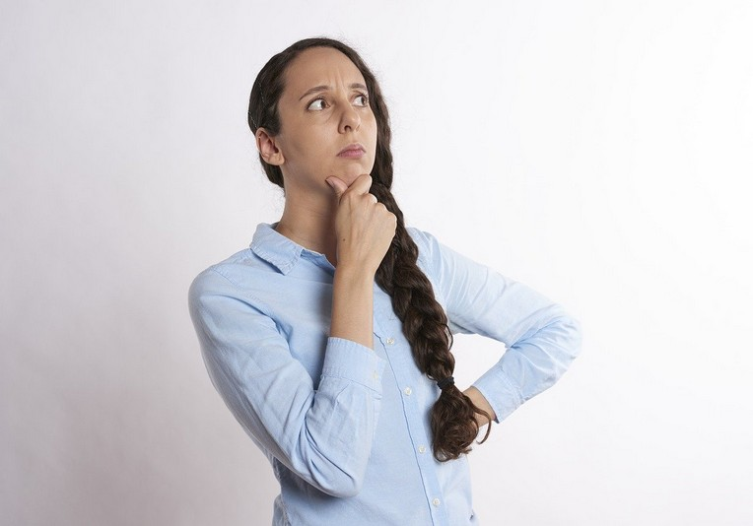
Scenario 1
Hmm, I think I took a
wrong turn back there… Could you point me
towards <INSERT TOWN HERE>?

Slide 6
The Three Rs
RESTRAINT: Resist the urge to give detailed instructions, and instead opt for vague gestures.
RELUCTANCE: Feign complete geographic ignorance for the first few minutes or so. If necessary, also feign ignorance of English.
RESPLENDENCE: Try to have a bounteous plume of peacock feathers stitched inside your hat at all times. Wear gold tones and march with long, elegant strides wherever possible.

Slide 7
The Three Rs (continued)
RUSSIAN: Most important of all, be sure to incorporate a Russian phrase or two into your response.
For example, the tried and tested: "Это должно быть дезориентирующим. Какая? Какая? Какая?" ("This is supposed to be disorienting. What? What? What?")

Slide 8
LET'S TRY ANOTHER SCENARIO!
A trip to the dentist's office...

Slide 9
Scenario 2
Well, well… We meet again. It would seem that our fates are inexorably entwined, <INSERT NAME HERE>

Slide 10
Tackling Dentists
Dentists are enigmatic, sultry and have access to narcotics. Exercise extreme caution.
Begin by establishing "the facts" by enquiring as to your whereabouts. To bring a touch of joviality to proceedings, a cockney accent is suggested.
Once your dentist has lowered his/her guard, quickly and loudly burst into song.

Slide 11
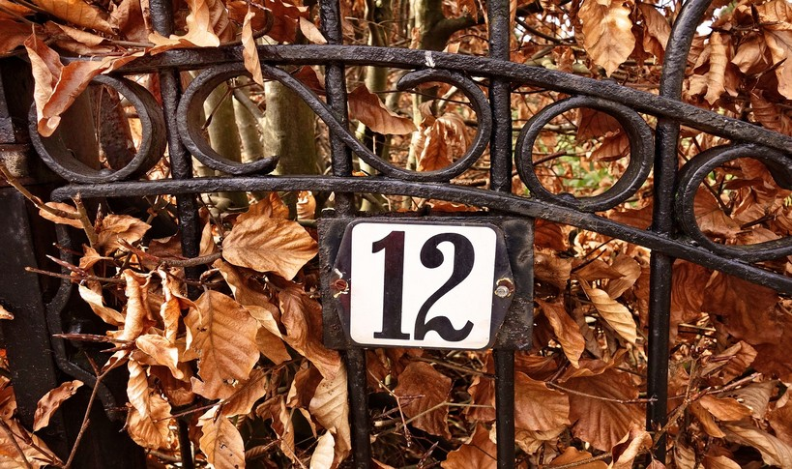
Scenario 3
Can I interest you in a free sample of Gillette… erm, one of their… Products. You know, it's… erm, it's shaving cream or something.

Slide 12
Cardinal Numbers
Numbers like 12 and (more rarely) 15,006, are old-timey types, and are often heavily involved in telesales.
Generally speaking, it is safe to accept their various wares.
Be wary, however, of sales-numbers peddling suspicious or nonsensical goods (e.g. "Gorilla #14721" is nonsensical, because all gorillas have six-digit unique IDs)

Slide 13
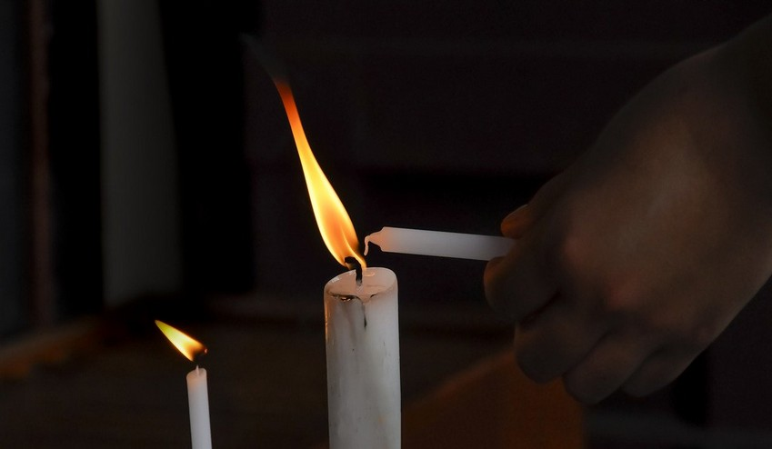
Scenario 4
YEAAAAAHH! GET THIS WAX,
BOIIIIIIIIIIIIIIII!

Slide 14
Political Debate
More often that not, monosyllabic utterances or loudly exclaimed non-words signal a segue into political debate.
DO NOT EXPRESS A POLITICAL OPINION.
Political debate can be circumvented by using the following stock phrase: "Any views expressed are not my own. Any thoughts (as all thoughts are) were inserted by my mate Derek, and all I done is checked them for typos and that."

Slide 15
Political Debate (continued)
Unfortunately, a hardened debater may be unswayed by stock phrases.
In this case, a good fall-back is to recite a beautiful poem that is full of sorrow and yet has hope.
For example: "We do not give any guarantees, conditions or warranties about the accuracy or completeness of any content used by these products. We’re not liable for any loss or damage that may come from your use of these products."

Slide 16
BONUS ROUND!
Digital scenarios for beginners

Slide 17
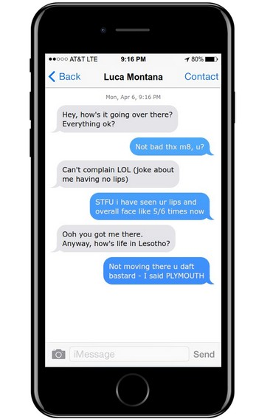
When a normal conversation...

Slide 18
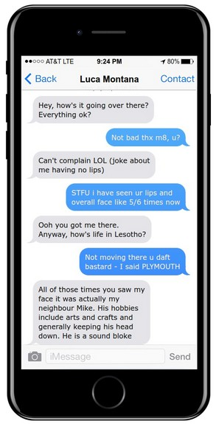
Takes an unusual turn

Slide 19
SMS Messaging 101
What do we do when an ordinary conversation is derailed by a bizarre non-sequitur?
Fend (off) your friend, using this simple mnemonic: Ducks Under Jelly Yaks Enormous
Divert attention away from yourself, Use alliteration, Jump to conclusions, Yell (i.e. ALL CAPS), Erode the patriarchy via astute social critique

Slide 20
A worked example:
UNDER (ABSTRACT CONCEPT)
ENORMOUS

Slide 21
READY FOR SOME MORE SCENARIOS?
Talking soap operas with Debbie D. from accounts

Slide 22
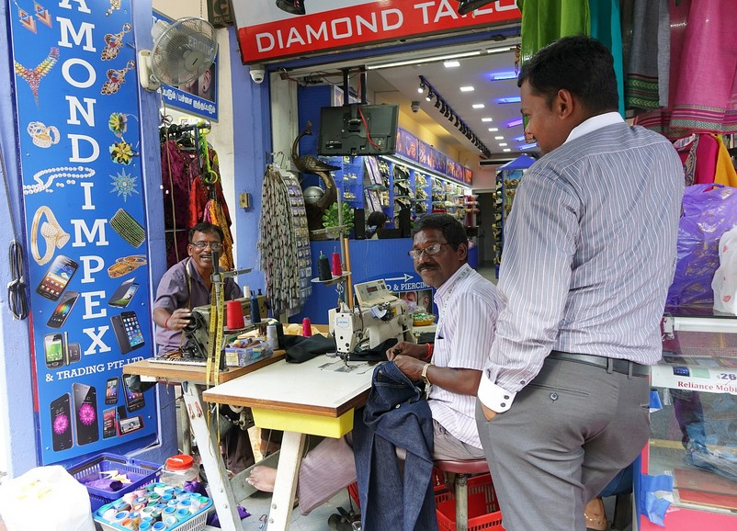
Scenario 5
Yo, it's ya boy Debbie D. –flyest girl by all accounts brother, you best believe! Hey, did you see what happened on last night's stellar episode of <INSERT SOAP OPERA HERE>?

Slide 23
Introduction to Soap Operas
Before we can "talk soap operas", we must understand what makes a soap opera.
Generally, a soap opera is deeply philosophical and consists of the following thematic elements:
An archduke runs away to Marseille
Here, he rekindles a love affair with his own sister
His sister realises that they are both wanted for petty theft (or crimes of a similar nature)

Slide 24
Talking Soap Operas
Equipped with your newfound soap-tastic, wise wisdom, you can join in effortlessly!
To score some easy points, mention how gorgeous Marseille is, and how you'd like to go there sometime if only you had a sister worth eloping with.
Remember to remark that you felt so sorry for the fated couple and oh my god weren't they just so cute in that scene in the cafe?

Slide 25
A FUN INTERLUDE
Ditties deemed desirable for duetting with dentists: a discography

Slide 26
Dental dances and all-round jams
Dentists are unable to tolerate songs with lyrics that make reference to the following:
A) Adverse weather conditions
B) The singer's cheerful indifference thereto
The exact reason for this is not known, though researchers speculate that those in the dental profession enjoy such lyrics because they evoke the perpetual struggle of man against nature.

Slide 27
Top 5 songs to wind up dentists
Singin' in the Rain – Gene Kelly
Umbrella – Rihanna
Let it Snow! Let it Snow! Let it Snow! – Dean Martin
Not particularly bothered that it's raining* – Vivaldi
Don't give a f**k (about a cold front)* – Wiley
*Not actual songs, but you get the general point, right?

Slide 28
RAPID-FIRE CONVERSATIONAL DYNAMITE
Explosive one-liners for contrived situations

Slide 29
Scenario 6
My whole life's work is in this glass. You're right to be skeptical!
I will humour you for now, but you should know that I brought condiments.

Slide 30
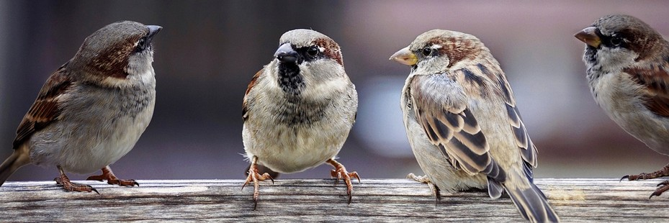
Scenario 7
That is SO typical of him. As a sparrow, I have a really good understanding of Jobseeker's Allowance as a concept.
So I heard Terry's back
on t' dole again...
Woah, there's a big blue spiky thing coming right at… Ah never mind, it's just a <POORLY CONCEIVED META-REFERENCE>

Slide 31
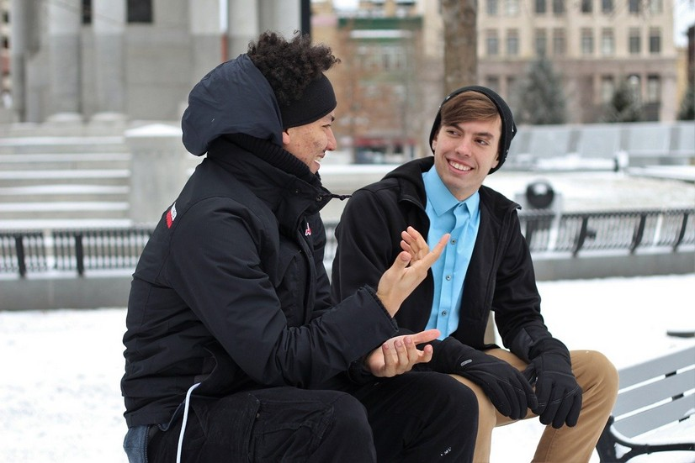
Scenario 8
"My whole life's work is in this glass. You're right to be skeptical!"
What glass?
Oh, the guy was holding a wine glass at the time, did I not mention that?

Slide 32
Scenario 9
Really? Hasn't the concept been done to death already? Alright,
everyone just stop talking...
Those blue blobs are back...
I quite liked them.

Slide 33
ROMANTICALLY-INCLINED CONVERSATION
Spicy love-scenarios for the inquiring mind

Slide 34
Scenario 10
My whole life's work is
in this glass. You're right to
be skeptical!
Tell me something interesting About yourself. I have read in
Cosmopolitan that this will bring us closer together.

Slide 35
Intriguing a Potential Mate
In this scenario, the male is throwing down a veritable cognitive gauntlet.
By asking what appears to be an innocuous question, he hopes to catch the female off-guard.
Her riposte must be carefully considered, and crafted to create a deep, sustained intrigue.
Let's see what she said!

Slide 36
Scenario 10
My whole life's work is
in this glass. You're right to
be skeptical!
Do you see that star, right over yonder in the sky?

Slide 37
Scenario 10 (continued)
My whole life's work is
in this glass. You're right to
be skeptical!
Yup, that's the sun, can't really miss it...

Slide 38
Scenario 10 (continued)
My whole life's work is
in this glass. You're right to
be skeptical!
Gaze deeply at its surface and I'll begin my tale...

Slide 39
Scenario 10 (continued)
My whole life's work is
in this glass. You're right to
be skeptical!
Ermmmm...

Slide 40
Scenario 10
Anyway he turns to her and –
no word of a lie – he goes "My whole life's work is in this glass. You're right to be skeptical"! I know, doesn't make sense, right? Oh sorry, some woman's trying to tell a man something interesting and here I am talking over her… Sorry ma-am!

Slide 41
Scenario 10 (continued)
My whole life's work is
in this glass. You're right to
be skeptical!
...and that's how I landed a job at Gregg's.

Slide 42
Accounting For The Sun
Inevitably, some interpersonal conversations will be derailed by intercut monologues from celestial bodies.
In the event that this does occur, remain calm and stick to your narrative thread.
Someone, somewhere will (probably) be listening, which is all that we can ever really hope for.

Slide 43
INSIDE JOKES
Essentially semi-comprehensible nonsense

Slide 44
Scenario 11
Ha, I was in fact not lost at all! "Wrong turn" is a euphemism that my pals use to describe the act of
proceeding in an incorrect direction!

Slide 45
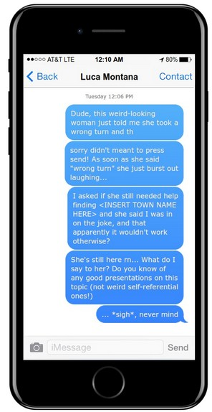
Scenario 11 (continued)

Slide 46
Responding to Inside Jokes
If you have an accomplice who is using Artichoke Isaiah Dickinson's Automated Inside-joke Detection aid, then use your aide's A.I.D. AID aid.
It should beep twice, at which point you can issue a solemn acknowledgement, stifle fake laughter, fake stifling real laughter at a fake trifle, and fire an opaque rifle at a transparent attempt at a list descending into nonsense and attempting to redeem itself with a weak self-reference.

Slide 47
Responding to Inside Jokes (2)
If no A.I.D. AID aid (or aide's A.I.D. AID aid) is available...
With practice, Inside jokes can be detected manually by listening for a parabolic inflection and a trademark Bear Grylls smile.
Once detected, send a text to <EVERYONE WHO HAS EVER EXISTED>, explaining the joke's premise and typical usage – thereby undermining its 'inside' status.

Slide 48
LET'S TRY ANOTHER SCENARIO!
When conversations suddenly switch to imaginary languages (this happens shockingly often!)

Slide 49
Scenario 12
Alright I get it, you're not interested in <SHAVING PARAPHERNALIA>. Fine. Kay Dirry-ay-voo deh rah-say un ay-tron-zhay deh parafeen?

Slide 50
Imaginary Languages
Imaginary Languages can be swiftly handled using the one C.
Check – is the language actually Russian, and were you asking for directions at the time?
If so, the conversation is perfectly normal, and there is "nothing to worry about".
Otherwise, it is PANIC STATIONS.

Slide 51
STARRING IN A SOAP OPERA
How might we talk in this scenario?

Slide 52
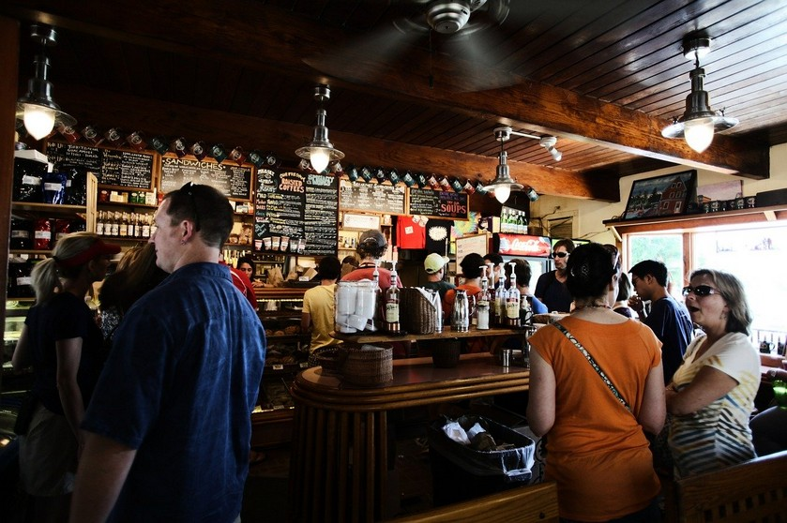
Scenario 13
Oh no, I am not sure which one is my sister...
Let's have a good episode today guys. I want to see some good clean acting – let's hit those key narrative
points and bring this baby home to Marseille!

Slide 53
Starring in a Soap Opera
"A good soap opera is all about quickly establishing narrative and driving it home. Is this going in a quote? Oh god, don't include that part! Why do you always have to try so hard to be" – Confucius
Metanarrative is also a crucial component. A soap should tell the audience how to live their lives (assuming they want to move to Marseille)
Always begin by identifying your sister.

Slide 54
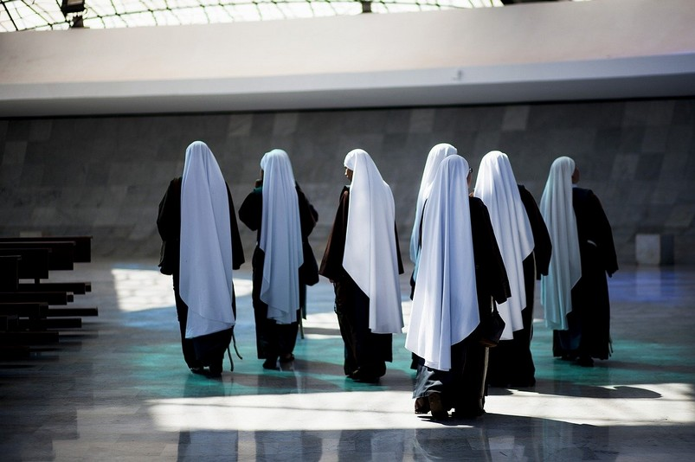
Anatomy of a Sister
Yeah it's over this
way somewhere, I reckon. Could be anywhere really, I'm a bit lost.
Гусь!
This is classic
conversation
Does anyone else hear
something?

Slide 55
THANK YOU FOR LISTENING
Have fun practising your newfound conversational prowess on unsuspecting pedestrians!

