Slide 1
Fabricated! A largely made-up visual history of linen
Pierre-Édouard Lémontey

Slide 2
Bartholomew "Barry" Linen (1946-87)
Barry Linen was a self-described simple man, who feared God and always folded his handkerchief neatly.
I describe myself as "simple"
in a jokey, self-effacing way. I hope
this comes across and people
don't think I'm being serious...

Slide 3
Bartholomew "Barry" Linen (1946-87)
Barry dreamed of isosceles triangles in beige, and his favourite meal was "yoghurt on its own".
God – if you're listening – I don't
want the story of my life to begin with
dull testaments to my mundanity. I
want to use my time to weave great
tales that future generations will
recite to mostly indifferent audiences

Slide 4
Bartholomew "Barry" Linen (1946-87)
One particularly stormy evening in the autumn of 1912, Barry left home as usual for his community tap-dancing club.
In fact, weather conditions were so poor on this evening that the local weatherman would describe the evening as "basically a write-off" and "worse than that time in the bible when it rained a lot".

Slide 5
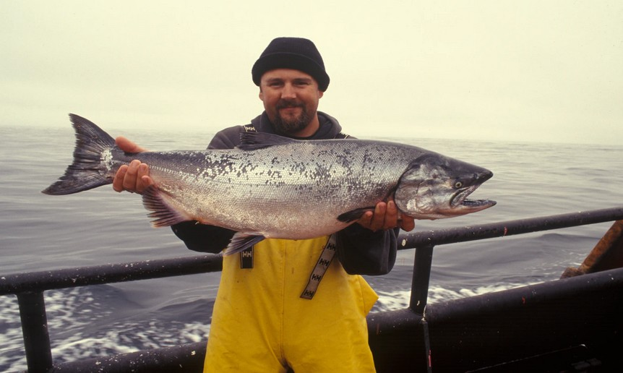
Bartholomew "Barry" Linen (1946-87)
Thanks Jim. Yes it
really is p*ssing it
down out there. Truly
a deluge of biblical
proportions.
Cheers Phil, now let's
catch up with Gary for
all of today's sporting
news

Slide 6
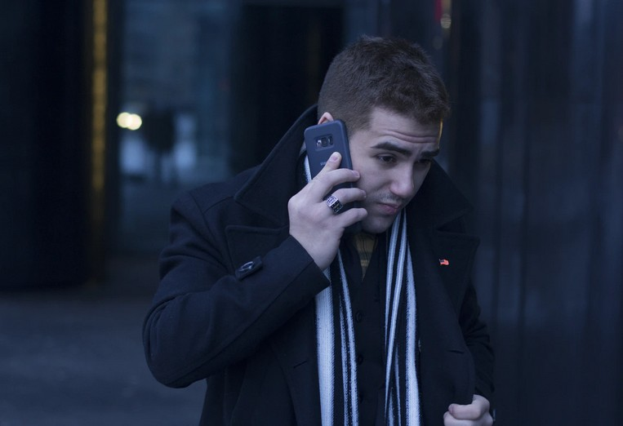
Bartholomew "Barry" Linen (1946-87)
Yeah and– oh, sorry
love I'll have to call
you back. Yeah going
on air literally right
now. Alright, see ya!

Slide 7
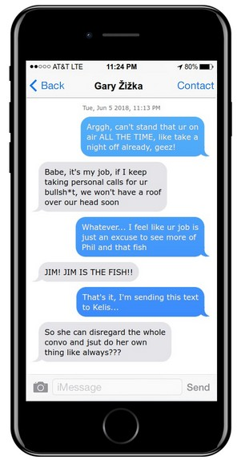
Bartholomew "Barry" Linen (1946-87)

Slide 8
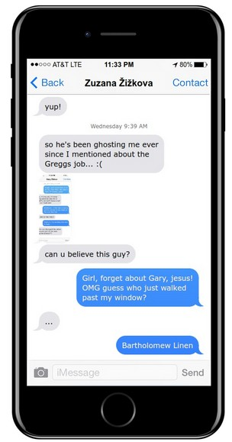
Bartholomew "Barry" Linen (1946-87)
PING!

Slide 9
Bartholomew "Barry" Linen (1946-87)
Wow, I haven't seen Barry since high
school… Can't believe it's been 10 years
already. The last 5 just flew by… Seems
like only yesterday we were those kids,
standing on the pier getting lost in
another one of Linen's tall tales...

Slide 10
Bartholomew "Barry" Linen (1946-87)
–but the brave boy wasn't phased.
He laid down and began to photograph
this enormous dog, and–
Did the dog eat him?

Slide 11
Bartholomew "Barry" Linen (1946-87)
We meet again, dog.
Do you eat me in this
story?
Matthew.
Not in this one, no.

Slide 12
Bartholomew "Barry" Linen (1946-87)
So… I can just go home
once I've got this shot?
I mean, I don't see why
not… Why do you crave
the approval of a dog?

Slide 13
Bartholomew "Barry" Linen (1946-87)
Remnants from Matthew's diary suggest that his encounter with Dog troubled him for many months after this encounter.
Later in life, his wife Marie would remark that "if one were to peel off his skin all onion-like, one would find the word 'Dog' etched innumerably upon his soul like an old school desk"

Slide 14
Bartholomew "Barry" Linen (1946-87)

Slide 15
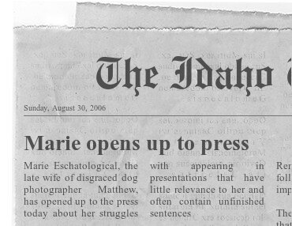
Bartholomew "Barry" Linen (1946-87)
Following Marie and Matthew's eventual divorce in 2010, the former opened up to the press about her

Slide 16
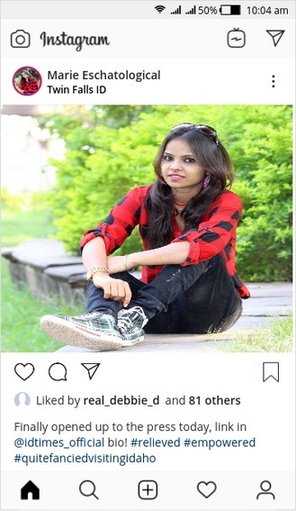
The Idaho Times
Marie would later remark that she had
A) experienced a profound sense of relief after finally opening up to the
B) always "quite fancied visiting Idaho"

Slide 17
The Idaho Times
A newspaper with relatively limited success
Catapulted to much more widespread readership following Marie Eschatological's historic interview
"When we ran [the interview] everything changed, pretty much overnight. Every star shone a little brighter from that moment, birdsong sounded more joyfully" –
Editor, Idaho Times

Slide 18
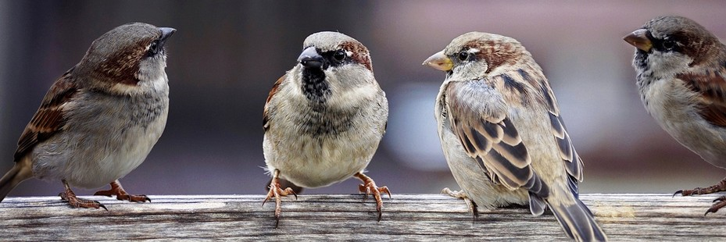
The Idaho Times
As a sparrow,
I have a really good understanding of
journalistic interviews as a concept.
Marie's was frankly average.
I was unmoved.
Nah we didn't, we just sang
the same as normal!
If our song sounded more cheerful, it was
coincidence – nothing more. Besides, Dave
here had just lost his missus, so he wasn't
exactly feeling chipper! Mind you, Dave
never is...

Slide 19
The Idaho Times
–is in this glass.
You're right to be skeptical"! Yep,
literally that. Ah I can't believe it's
taking this long to explain, it's honestly not
really worth it… Seriously wasn't even that
funny. No, it's not a reference to anything!
What did she say? She just said she
would humour him, basically.

Slide 20
Bartholomew "Barry" Linen (1946-87)
Barry arrived at the tap-dancing club after several minutes.
Only the instructor was there, the rest of the punters having been dissuaded by the evening's inclement conditions.
Sources suggest that several would-be tap-goers had tuned in to the weather broadcast and decided to stay home.

Slide 21
Bartholomew "Barry" Linen (1946-87)
We're on again?
What? Why? It's only
been a few minutes!
Alright so obviously
it's erm, it's still
raining. Same as
before really...

Slide 22
Bartholomew "Barry" Linen (1946-87)
Wonderful form,
Bazza! I feel safe –
safe from that
wretched downpour
beyond these walls!

Slide 23
Bartholomew "Barry" Linen (1946-87)
Cheers, Steph. That's
really heartening.
Sometimes I feel like
people don't see me
for who–

Slide 24
Bartholomew "Barry" Linen (1946-87)
Why do I always feel like an extra
in a biopic about someone else's
life? Is it my own fault? Maybe I should
be more assertive, perhaps… There will
be no books written about me,
nor seminars given… Am I condemned
to this? A footnote in the history of
someone more notable?

Slide 25
Bartholomew "Barry" Linen (1946-87)
A sound-bite doing a poor
impersonation of an impersonation
of something approaching coherence.
Thoughts, beliefs, motives imposed
Upon me after the fact to suit the
narrative of some well-meaning but
treacherous scholar.
And what of my dreams? Oh to be
young again! How I would cherish that
realm in which everything is
possibility

Slide 26
Bartholomew "Barry" Linen (1946-87)
Bazza, will you indulge
me a moment? I used
to have the most
vivid daydreams in
GCSE chemistry...

Slide 27
Bartholomew "Barry" Linen (1946-87)
–which is why covalent
Bonds are not at all
well-illustrated by a line
graph that seems to be
related more to
economics now that
I think about it…
Stephanie! What's the
matter – am I keeping
you up?

Slide 28
Bartholomew "Barry" Linen (1946-87)
*Daydreaming*

Slide 29
Bartholomew "Barry" Linen (1946-87)
Ah what's the point?
Actually, Steph, you
remind me of you at
your age. I mean,
obviously, right? Now,
what was I saying?
Ah yes, right. Covalent
bonds. Now, basically...

Slide 30
Bartholomew "Barry" Linen (1946-87)
*sigh* I know, Fish.
Steph, you should be
learning about electrons
and such

Slide 31
Bartholomew "Barry" Linen (1946-87)
Fish, you are present in everyone's
daydreams, but where do you go
to when you yourself dream?
I swim through worlds,
Steph, feasting on
whatever fragments of
narrative I encounter

Slide 32
Bartholomew "Barry" Linen (1946-87)
Can I come with you, Fish?
For a few seconds only.
Hold your breath, Steph!

Slide 33
Bartholomew "Barry" Linen (1946-87)
This seems like a good resting spot.

Slide 34
Bartholomew "Barry" Linen (1946-87)
Sorry about all that,
love. Done now.
Yeah, pretty good
thanks. I've been
thinking though, and–

Slide 35
Bartholomew "Barry" Linen (1946-87)
–which is due this Friday.
Pierre, that includes you!
And I don't want to see
any "quirky" meta
references in your
presentations this time,
please. So are we all clear
on what we have to do?

Slide 36
Bartholomew "Barry" Linen (1946-87)
Really great work on the
Eschatological interview!
Thanks. It will keep us afloat for now, but every
night when I get home and turn the lights off I
can't help feel we should be doing something…
Bigger, you know? Maybe it's just me...

Slide 37
Bartholomew "Barry" Linen (1946-87)
I can't help feel we should
be doing something…
Bigger. Much as this thought
plagues my waking hours, I
must clutch it tightly, because–

Slide 38
Bartholomew "Barry" Linen (1946-87)
Do you ever feel like there's this
cold, steady rain, even when it's sunny
out? For that matter, does it rain
here at all, Fish?
Hey, sorry just had a
particularly inquisitive
client before you. Overran
by quite a bit...

Slide 39
Bartholomew "Barry" Linen (1946-87)
Do you ever feel like there's this
cold, steady rain, even when it's sunny
out? For that matter, does it rain
here at all, Fish?
Difficult to tell, we don't
get no weather-people
in these parts. Let's call
Phil.

Slide 40
Bartholomew "Barry" Linen (1946-87)
Ping! We have a caller,
Phil! They're asking for
the forecast down in…
Oh, no. Sorry, no we can't
help there.

Slide 41
Zuzana Žižkova
Zuzana was a childhood friend of Barry's.
For much of her adolescence, she worked as a shop assistant in her father's patisserie.
The shop was considered by many to be a pillar of the local community, described in a tour guide at the time as a "veritably bustling hub of activity"

Slide 42
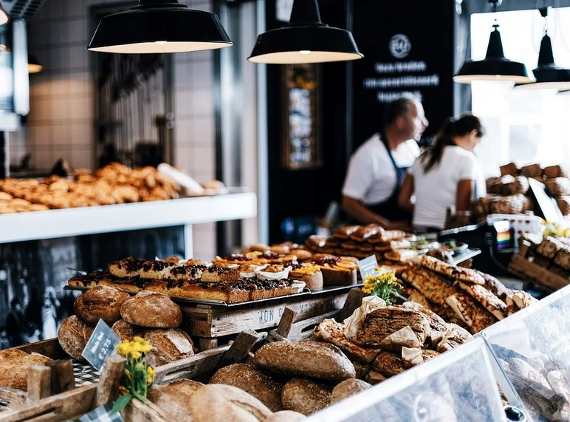
Zuzana Žižkova
Zuzka, have you written that review yet?
Here, let me see it! "Veritably" what? What
nonsense! Zuzi, no-one will believe this!
Maybe not today, but when
the patisserie is but a minor detail
in a far greater story, people
will not trouble themselves to question
such details.

Slide 43
Bartholomew "Barry" Linen (1946-87)
Alas, not his locality
apparently. Ah well, I have
another client soon now
Anyway.

Slide 44
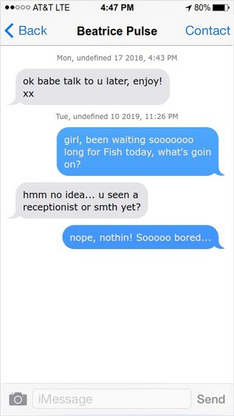
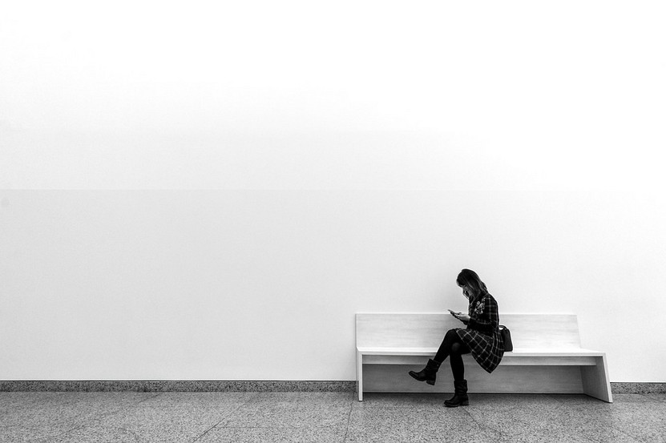
Bartholomew "Barry" Linen (1946-87)

Slide 45
Bartholomew "Barry" Linen (1946-87)
My apologies for the delay, Miss.
Fish will see you now. May I just ask before
we get started, what is the reason for
your visit today?

Slide 46
Bartholomew "Barry" Linen (1946-87)
Well yeah exactly! No,
that's fair enough. Oh
alright, that's not a
problem. See ya!

Slide 47
Bartholomew "Barry" Linen (1946-87)
Ok, that's probably enough for now
Steph. Actually quite enjoyed it to be
honest with you. Fare thee well!

Slide 48
Bartholomew "Barry" Linen (1946-87)
Well, what if I didn't want
to go home?
Really, you can do
whatever you like… Not
sure why you'd feel the
need to ask a dog...

Slide 49
Bartholomew "Barry" Linen (1946-87)
I just… I just can't face
seeing Marie again
just yet. I'm sorry.
It's ok, Matthew. Here,
let me tell you a story.

Slide 50
Bartholomew "Barry" Linen (1946-87)
In this story, Matthew, you're a mere figment of
the imagination of an amateur tap-dance
enthusiast who – in spite of his name – did not
and will not make any sort of contribution to
the textiles industry.

Slide 51
Bartholomew "Barry" Linen (1946-87)
All of our stories are connected, Matthew,
whether we like it or not. Anyway, it's a mild,
Autumn evening, and one Bartholomew Linen is
making his way to dance class.

Slide 52
Bartholomew "Barry" Linen (1946-87)
So, in summary,
temperate conditions
out there tonight.
Mild and looking like
staying that way.
A quick one today! And
now over to Gary for
today's sporting news.

Slide 53
Bartholomew "Barry" Linen (1946-87)
Are you serious?
Come on, you might
have known I'd be on
air at this time! Who?
Beatrice? Beatrice
Pulse? Blimey...

Slide 54
That Day's Sporting News
Despite a lack of coverage, the particular day in question had been a bumper day for sports fans.
Cheltenham Town had been Wycombe Wanderers, 2–1, thereby qualifying for promotion.
Their star striker, Shahamolah Squidders, had won the match ball, having scored twice.

Slide 55
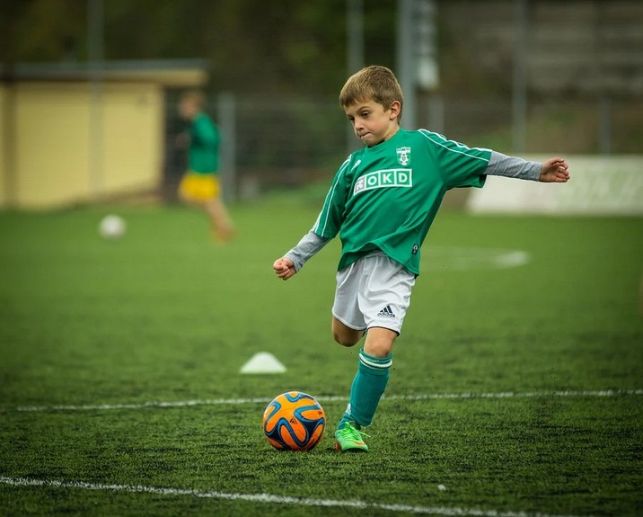
Bartholomew "Barry" Linen (1946-87)
I could stand here and tell you
about what the promotion means
and all that, but who wants to hear
that, honestly? Let's talk about you
instead! What drives you? How has
your day been so far?

Slide 56
Bartholomew "Barry" Linen (1946-87)
Wow, Shahamollah. I
don't know what to say.
Erm, I guess my day was
OK, but then again I…
How does the ball feel?

Slide 57
Bartholomew "Barry" Linen (1946-87)
Can't complain!

Slide 58
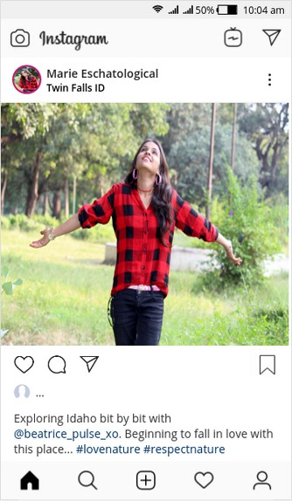
The Idaho Times
Marie stayed in Idaho for several weeks after her watershed interview.
In her memoir, she would attribute this to the "singular beauty of that part of the world"

Slide 59
Bartholomew "Barry" Linen (1946-87)
Zuzi, this is not a story about a dog eating
a man. I'm not the right person to tell you
such a story.
I always enjoy your stories
anyhow, Barry. Is not every
story, in its way, about a
dog eating a man?

Slide 60
Bartholomew "Barry" Linen (1946-87)
For sure, but only a subset dare to
acknowledge it. The remainder hide behind
their pretence of being about
some other thing

Slide 61
Bartholomew "Barry" Linen (1946-87)
A whole lifetime away, it seems now. As
though Barry were from a past life… How is it
that I still feel so connected to that time, and
yet there is this chasm between that present
and this present.

Slide 62
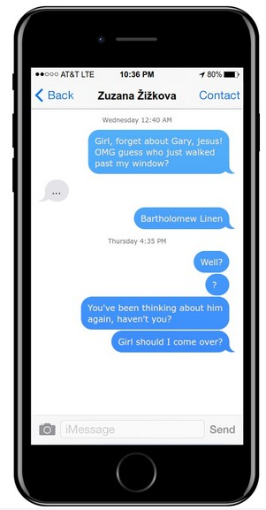
Bartholomew "Barry" Linen (1946-87)
PING!

Slide 63
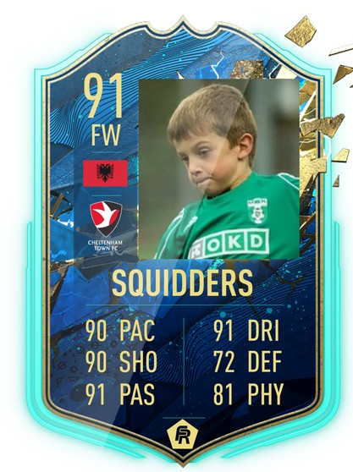
Shahamolah Squidders
Squidders was an Albanian centre-forward, who signed for Cheltenham Town aged only 10.
His father, Bigol, assumed the role of agent throughout Squidders' career.

Slide 64
Shahamolah Squidders
Squidders parted ways with Cheltenham Town shortly after their promotion, citing the following reasons:
A) He wanted to dedicate more time to preparing for his GCSEs
B) He felt that much of the hunger and artistry that "in hindsight could have been forged only from struggle" had been missing from Cheltenham's game of late

Slide 65
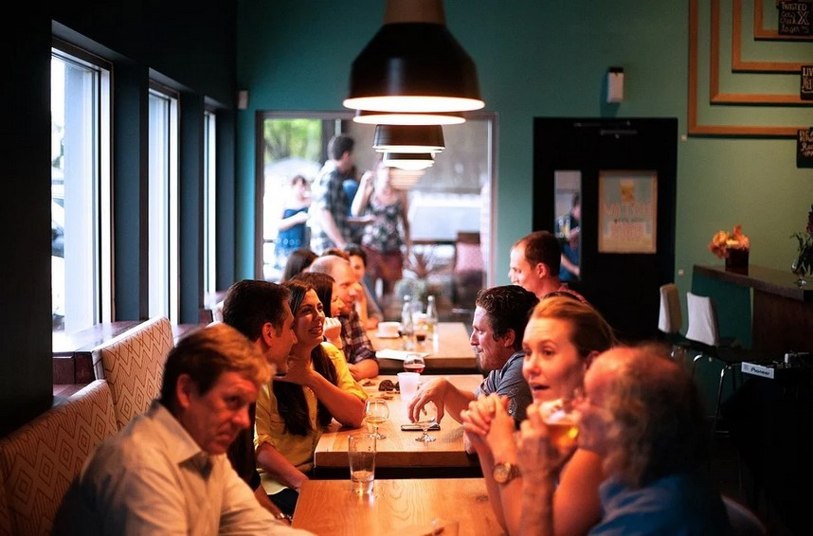
Beatrice Pulse
My dear Bigol, but what will become of us?
I know that the two of you have dreams
that span far beyond Cheltenham, and
cannot stubbornly stand in the way.
Beatrice, I–

Slide 66
Beatrice Pulse
Hang on – I'm so sorry, it's her again. Oh, she's
been called through for her appointment now.
Sorry do you mind if I give her a quick call?

Slide 67
Bartholomew "Barry" Linen (1946-87)
What's that? Absolutely
not! I'm not even going
to bother asking what
on earth you mean by a
"visual novel", but if you
hand in any more of that
nonsense to me then I
will not hesitate to fail
you for this module!

Slide 68
Bartholomew "Barry" Linen (1946-87)
Oh, I'm sorry. I was miles away!
What did you say? Oh, my reason
for–

Slide 69
Zuzana Žižkova
In later life, having sold her father's patisserie, Zuzana described Linen as "more an acquaintance than a friend. [I] do not hold him in any especial regard".
Of her husband Gary's brief, yet intense friendship with Linen, she simply quipped that "this was a friendship that transcended time's swirling, malevolent music"

Slide 70
Bartholomew "Barry" Linen (1946-87)
Oh don't worry about that, we have another scoop
on the horizon already! Why, just today we got wind
of a ball that was offered a rare platform to set
the world to rights, but remained silent and
now regrets squandering the opportunity.

